Slide 1
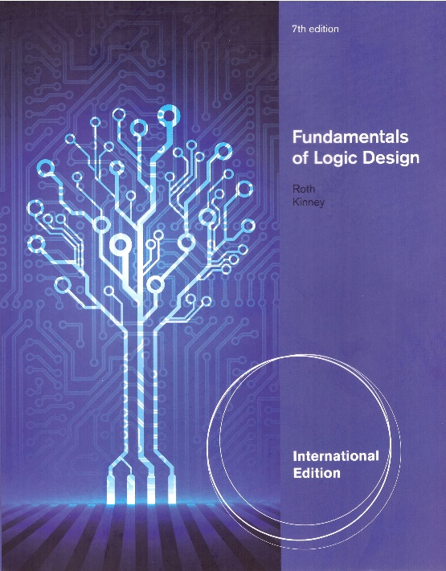
Unit 12
REGISTERS AND COUNTERS
This chapter in the book includes:
Objectives
Study Guide
12.1 Registers and Register Transfers
12.2 Shift Registers
12.3 Design of Binary Counters
12.4 Counters for Other Sequences
12.5 Counter Design Using S-R and J-K Flip-Flops
12.6 Derivation of Flip-Flop Input Equations--Summary
Problems

Slide 2
Objectives
Explain the operation of registers. Understand how to transfer data between registers using tri-state bus
Explain the shift register operation, how to build them and analyze operation. Construct a timing diagram for a shift register
Explain the operation of binary counters, how to build them using F/F and gates and analyze operation
Given the present state and desired next state of F/F, determine the required F/F/ inputs
Given the desired counting sequence for a counter, derive F/F input equations
Explain the procedures used for deriving F/F input equation
Construct a timing diagram for a counter by tracing signals through the circuit

Slide 3
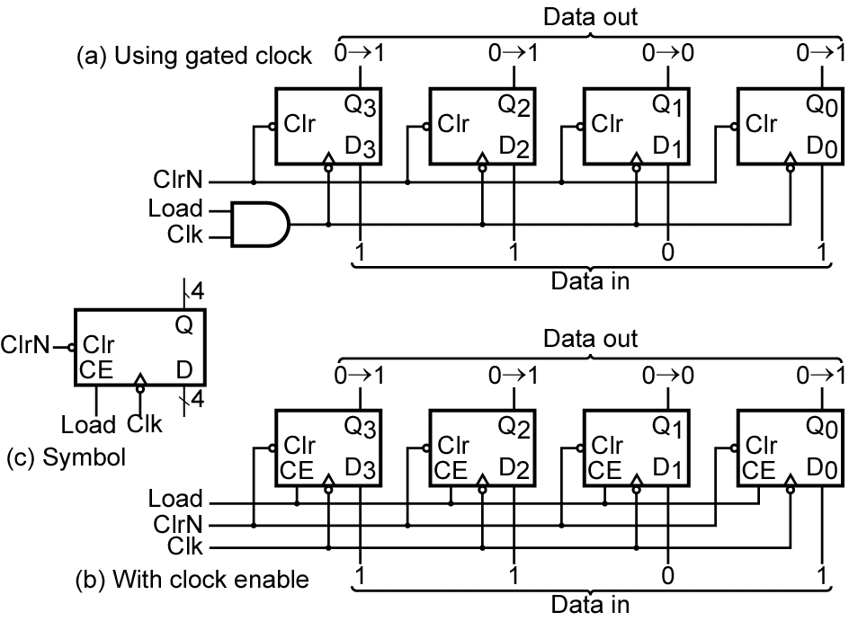
12.1 Registers and Register Transfers
Figure 12-1 4-Bit D Flip-Flop Registers

Slide 4
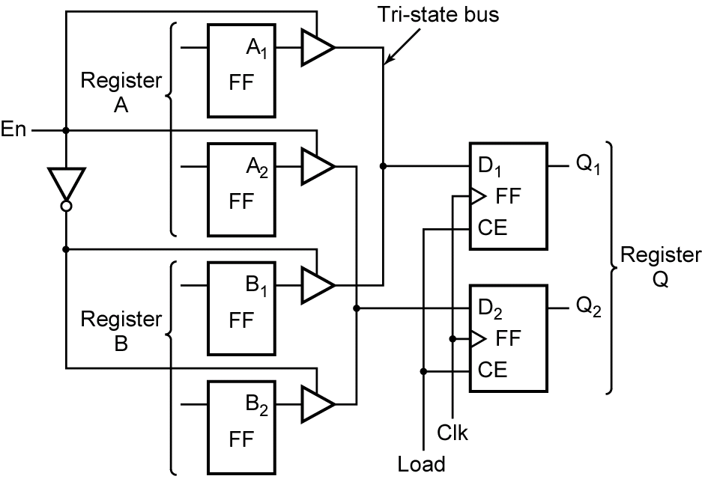
12.1 Registers and Register Transfers
Fig 12-2 Data Transfer Between Registers
Error?

Slide 5
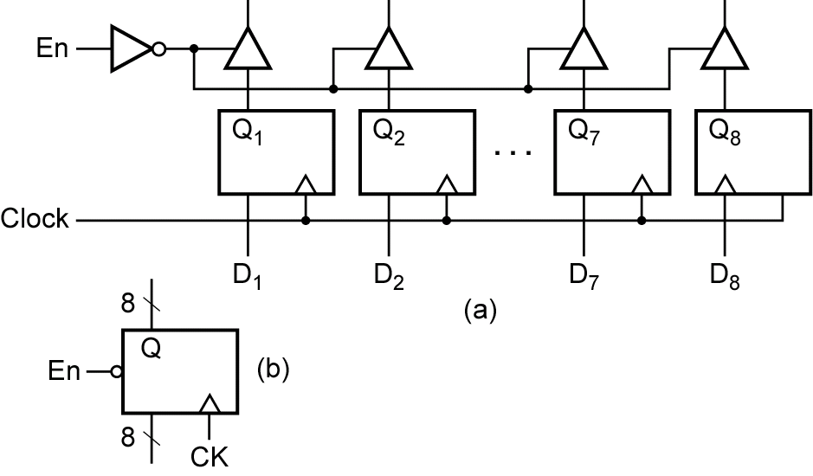
12.1 Registers and Register Transfers
Fig 12-3 Logic Diagram for 8-Bit Register with Tri-State Output

Slide 6
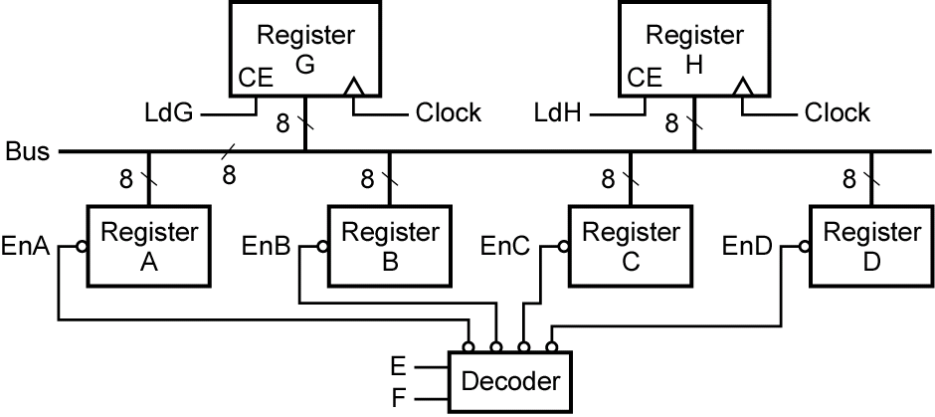
12.1 Registers and Register Transfers
Fig 12-4 Data Transfer Using a Tri-State Bus
Error?

Slide 7
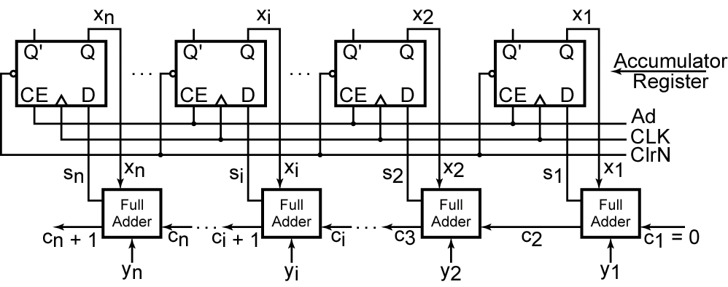
12.1 Registers and Register Transfers
Parallel Adder with Accumulator
Fig 12-5 N-Bit Parallel Adder with Accumulator

Slide 8
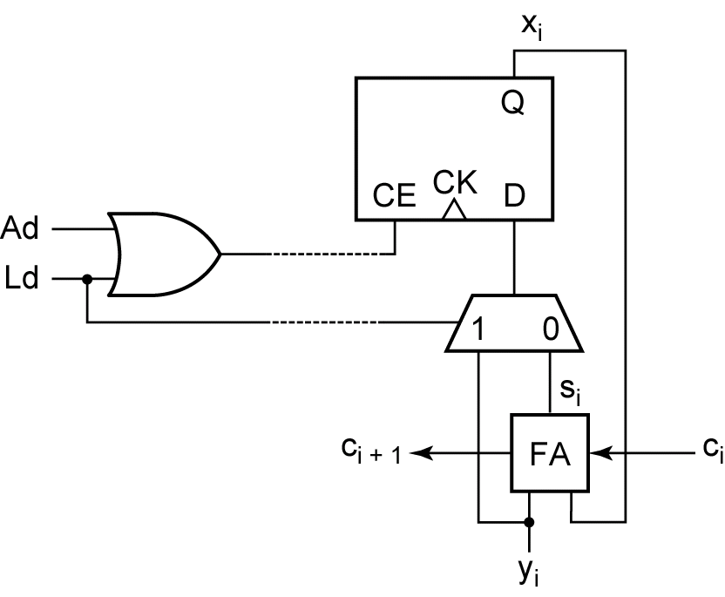
12.1 Registers and Register Transfers
Fig 12-6 Adder Cell with Multiplexer

Slide 9
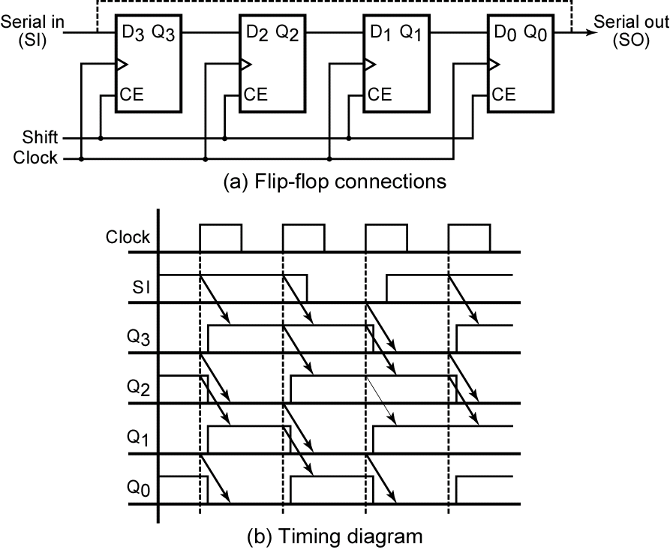
12-2 Shift Registers
Fig 12-7 Right-Shift Register
cyclic
Input sequence : 1 1 0 1
0101→1010→1101→0110→
1011

Slide 10
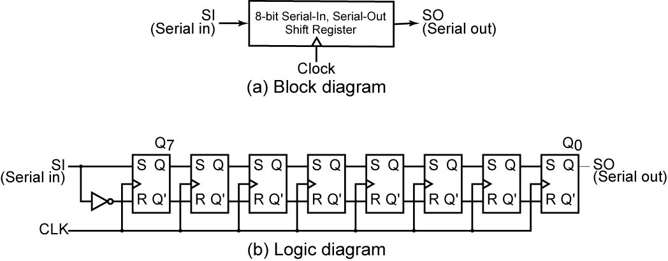
12-2 Shift Registers
Fig 12-8 8-Bit Serial-in, Serial-out Shift Register

Slide 11
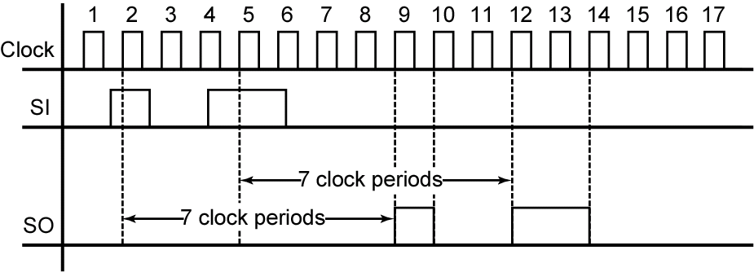
12-2 Shift Registers
Fig 12-9 Typical Timing Diagram for Shift Register

Slide 12
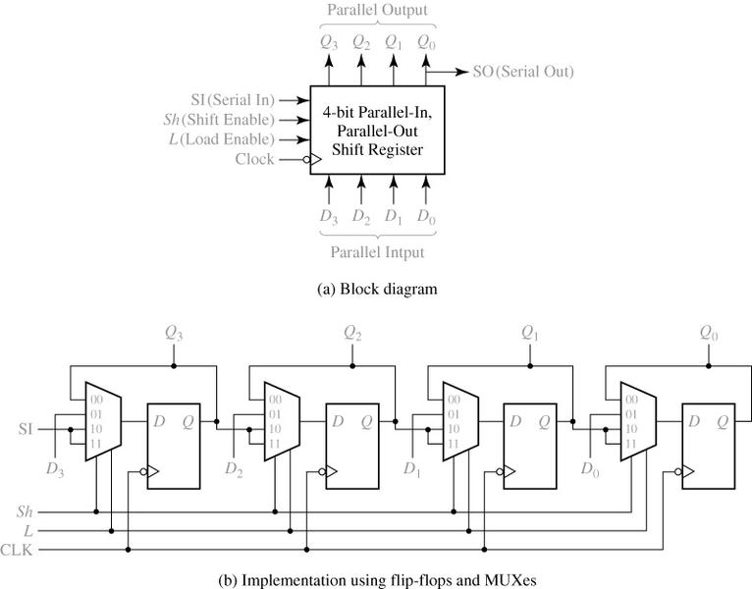
12-2 Shift Registers
Fig 12-10 Parallel-in, Parallel-Out Right Shift Register

Slide 13
12-2 Shift Registers
Shift Register Operation (Table 12-1)
The Next-state equations for the F/F outputs are

Slide 14
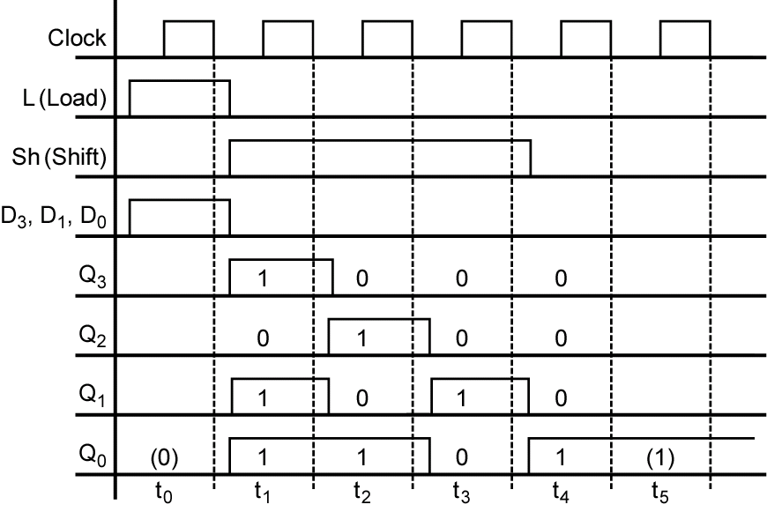
12-2 Shift Registers
Fig 12-11 Timing Diagram for Shift Register

Slide 15
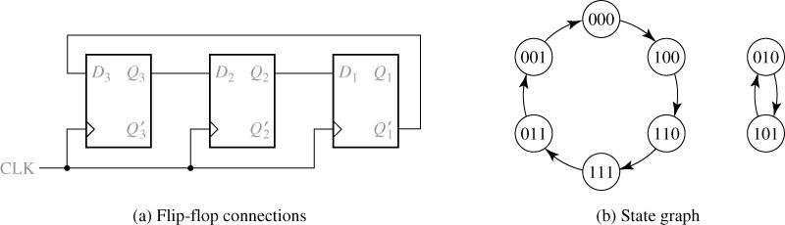
12-2 Shift Registers
Fig 12-12 Shift Register with Inverted Feedback
→ Johnson Counter
A 3-bit shift register
Successive states

Slide 16
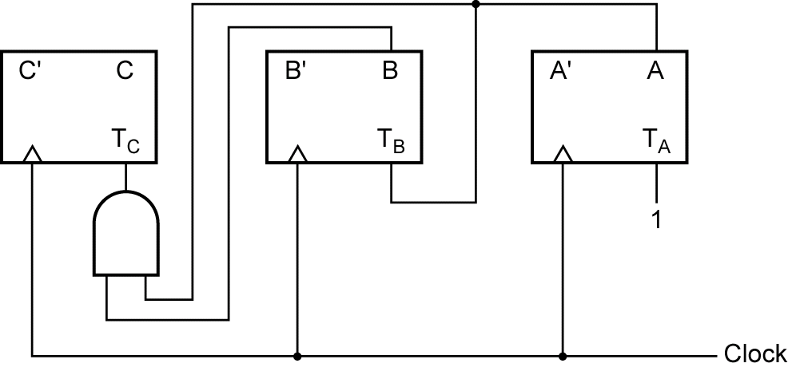
12.3 Design of Binary Counters
Fig 12-14 Synchronous Binary Counter
Counting sequence
CBA: 000→001→010→011→100→101→110→111→000

Slide 17

12.3 Design of Binary Counters
Counting sequence
CBA: 000→001→010→011→100→101→110→111→000
State Table for Binary Counter using T Flip-Flops (Table 12-2)
Use two fingers

Slide 18
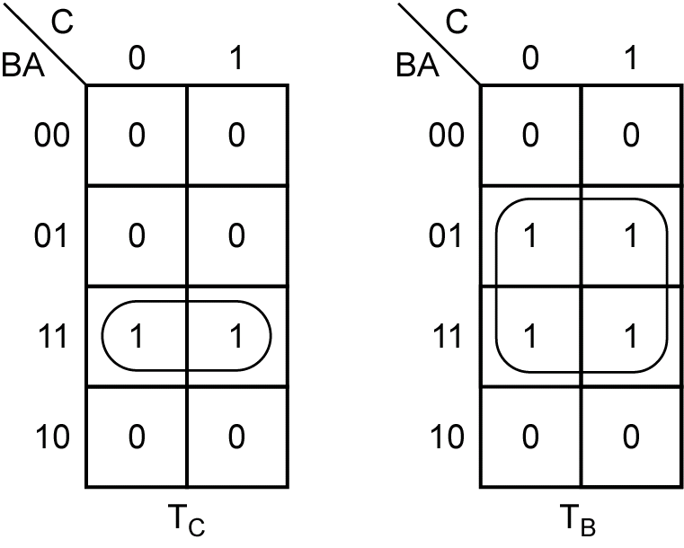

12.3 Design of Binary Counters
Fig 12-15 Karnaugh Maps for Binary Counter
index
middle
ring
thumb
little
T_{A}=1, T_{B}=A, T_{C}=AB

Slide 19
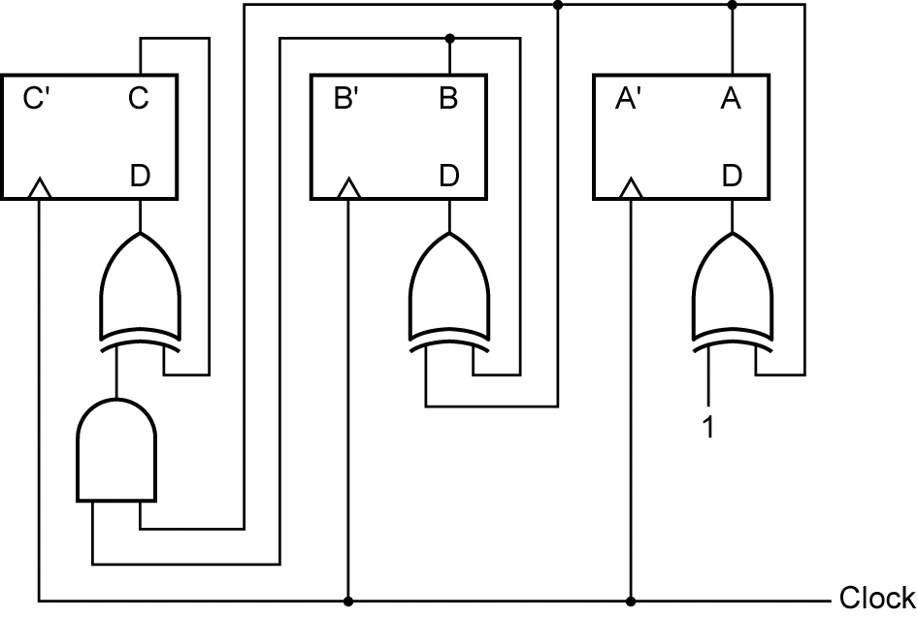
12.3 Design of Binary Counters
Fig 12-16 Binary Counter with D Flip-Flops

Slide 20
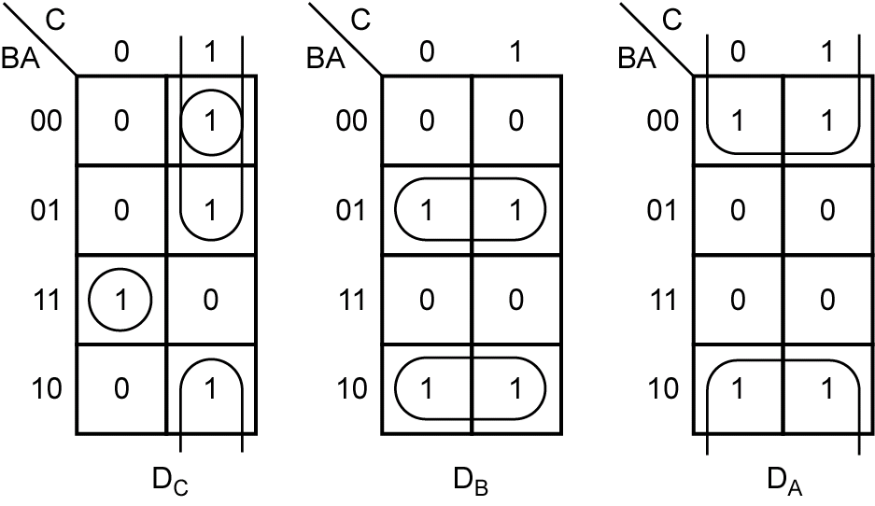
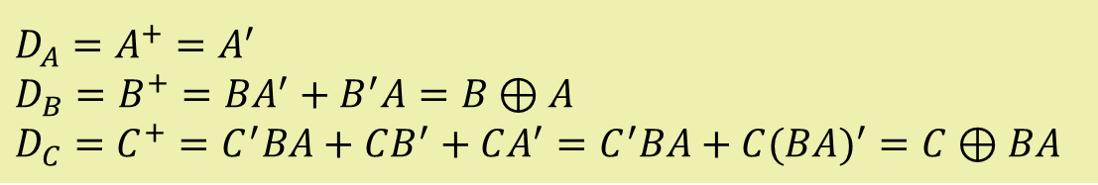
12.3 Design of Binary Counters
Karnaugh Maps for D Flip-Flops
The D input equations derived from the maps are

Slide 21
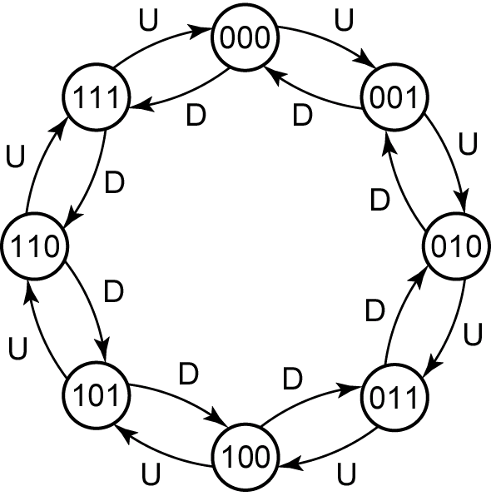
12.3 Design of Binary Counters
Fig 12-18 State Graph and Table for Up-Down counter
When U=1, Up counting
When D=1, Down counting

Slide 22
12.3 Design of Binary Counters
The corresponding logic equations are
When U=0 and D=1, these equations reduce to
When U=D=0, no change
When U=D=1, not allowed

Slide 23
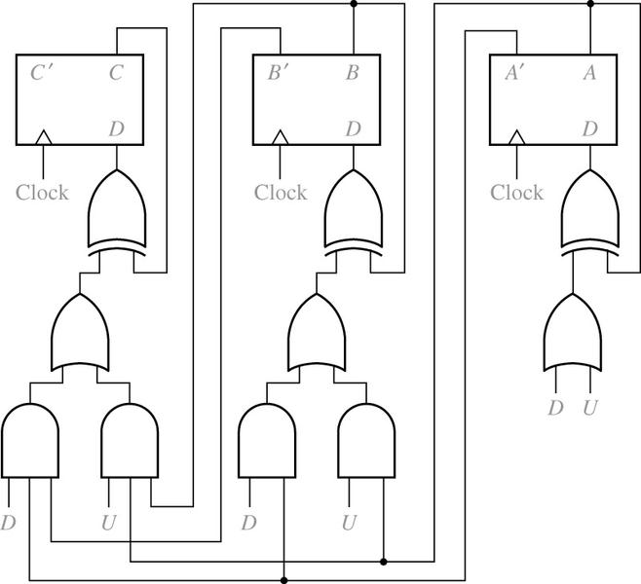
12.3 Design of Binary Counters
The up-down counter can be implemented using D F/F and gate
Fig 12-19
Binary Up-Down Counter

Slide 24
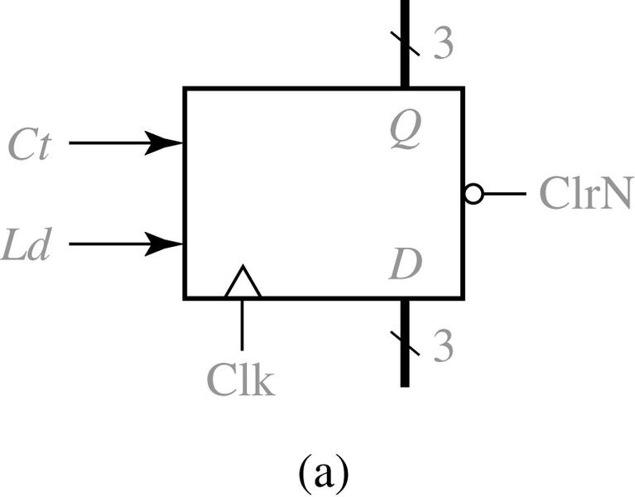
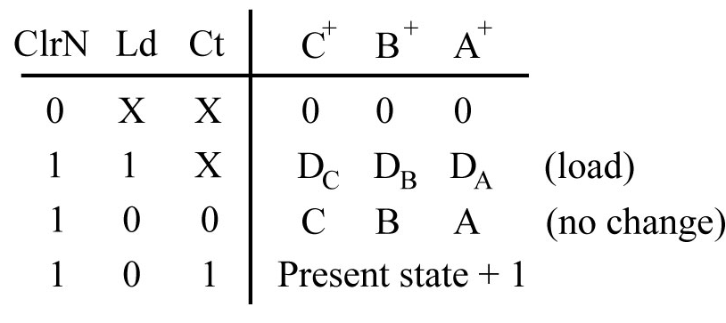
12.3 Design of Binary Counters
Fig 12-20 Loadable Counter with Count Enable
Summarizes the counter
operation

Slide 25
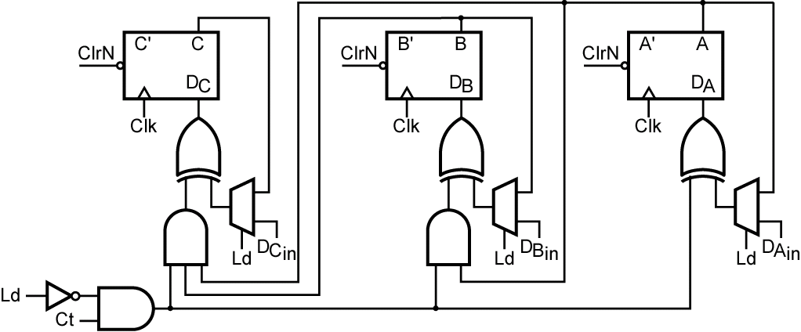
12.3 Design of Binary Counters
Fig 12-21 Circuit for Figure 12-20

Slide 26
12.3 Design of Binary Counters
The next-state equations for the counter

Slide 27
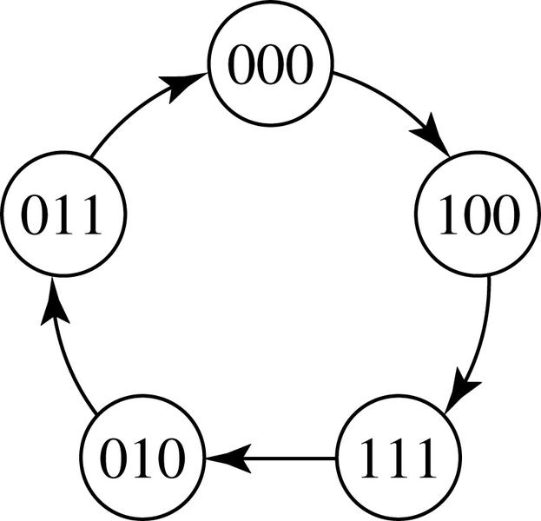
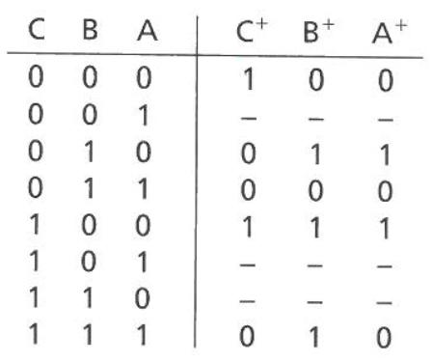
12.4 Counters for Other Sequences
The sequence of states of a counter is not in straight binary order.
Fig 12-22
State Graph for Counter
State Table for Figure 12-22
(Table 12-3)

Slide 28
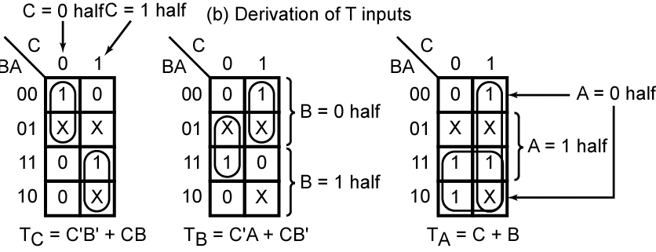
12.4 Counters for Other Sequences
Fig 12-23 The next-state maps are easily plotted from Table 12-3

Slide 29
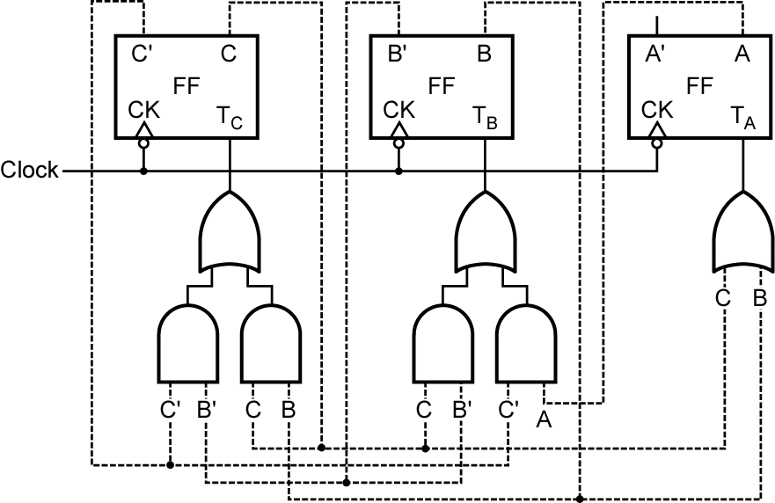
12.4 Counters for Other Sequences
Fig 12-24 Counter Design Using T Flip-Flops

Slide 30
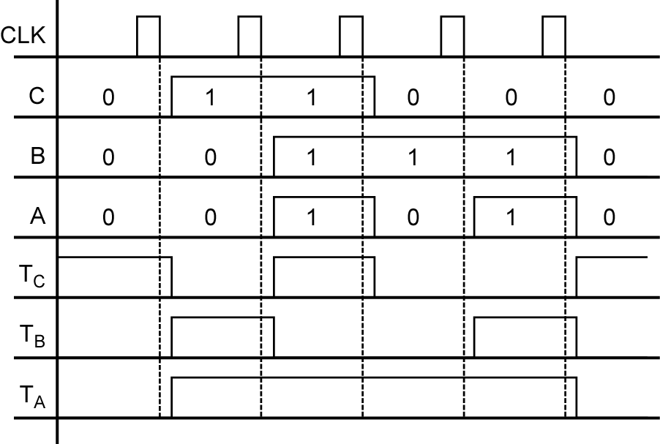
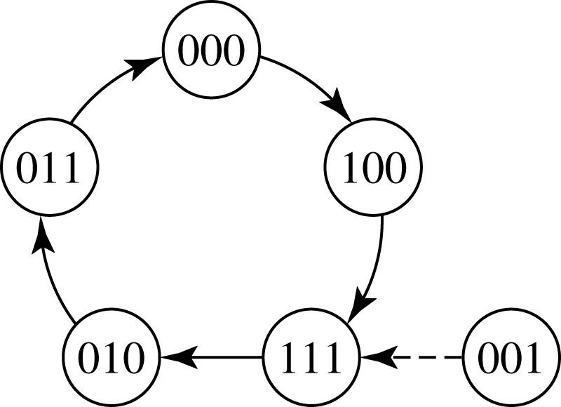
12.4 Counters for Other Sequences
Fig 12-25
Timing Diagram for Figure 12-24
Fig 12-26
State Graph for
Counter

Slide 31
12.4 Counters for Other Sequences
Summary:
Form a state table which gives the next F/F states for each combination of present F/F states.
Plot the next-state K-maps from the table.
Plot a T input map for each F/F .
Find the T input equations from the maps and realize the circuit.

Slide 32
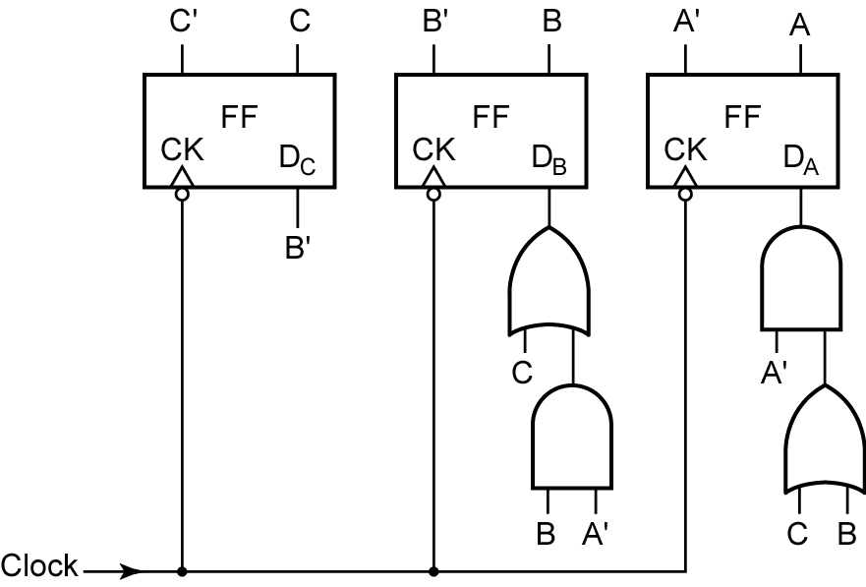
12.4 Counters for Other Sequences
Counter Design Using D Flip-Flop
Following equations can be read from Figure 12-22(a):
Fig 12-27
Counter of Figure 12-22
Using D Flip-Flops

Slide 33
12.5 Counter Design Using S-R and J-K Flip-Flops
S-R Flip-Flop Inputs (Table 12-5)
Excitation Table
Inputs not allowed
(a)
(b)
(c)

Slide 34
12.5 Counter Design Using S-R and J-K Flip-Flops
With columns added for the S and R flip-flop inputs (Table 12-6)

Slide 35
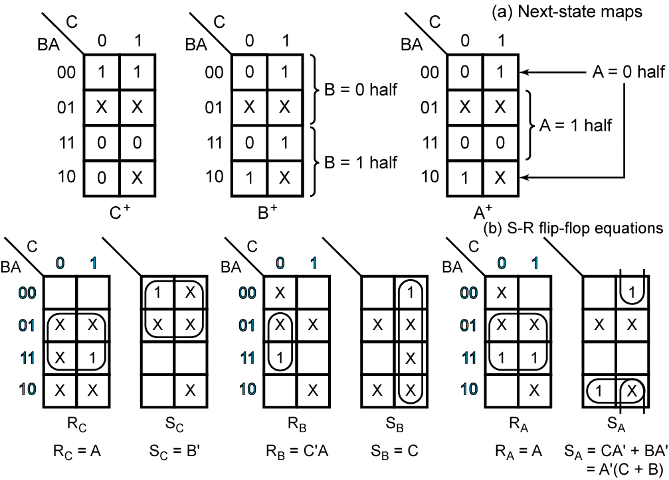
12.5 Counter Design Using S-R and J-K Flip-Flops
Fig 12-30
Counter Design
Using
S-R Flip-Flop

Slide 36
12.5 Counter Design Using S-R and J-K Flip-Flops
J-K Flip-Flop Inputs (Table 12-7)
Excitation Table
(a)
(b)
(c)

Slide 37
12.5 Counter Design Using S-R and J-K Flip-Flops
With columns added for the J and K flip-flop inputs (Table 12-8)

Slide 38
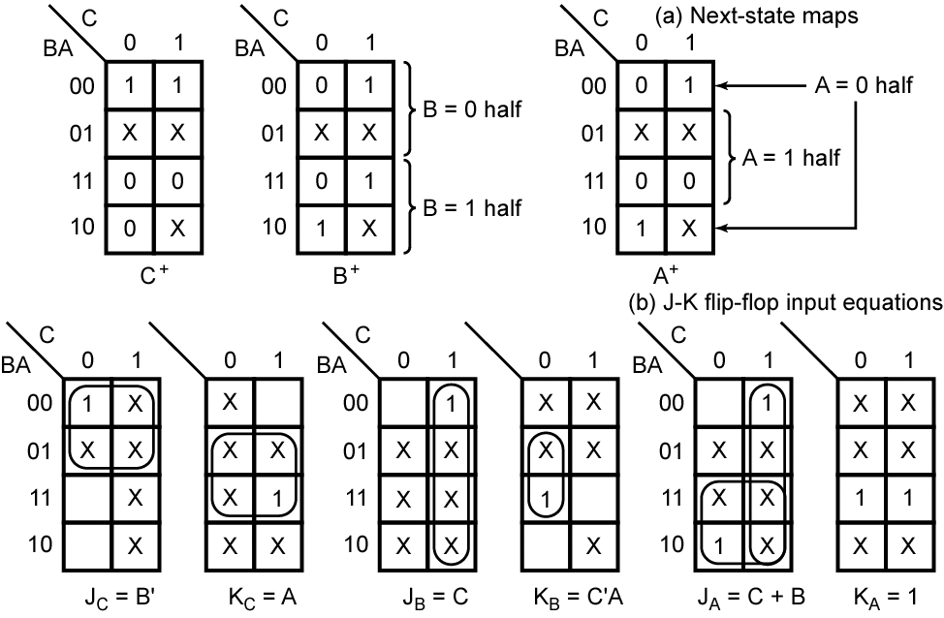
12.6 Derivation of Flip-Flop Input Equations-Summary
Fig 12-31 Counter of Figure 12-22 Using J-K Flip-Flops

Slide 39
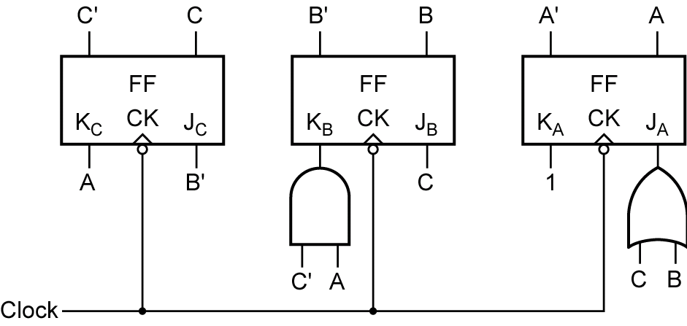
12.6 Derivation of Flip-Flop Input Equations-Summary
Fig 12-31(c) Logic Circuit (omitting the feedback lines)

Slide 40
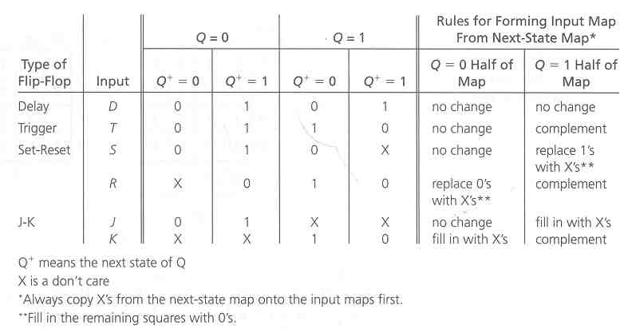
12.6 Derivation of Flip-Flop Input Equations-Summary
Determination of Flip-Flop Input Equations from Next-State Equations
Using Karnaugh Maps (Table 12-9)

Slide 41
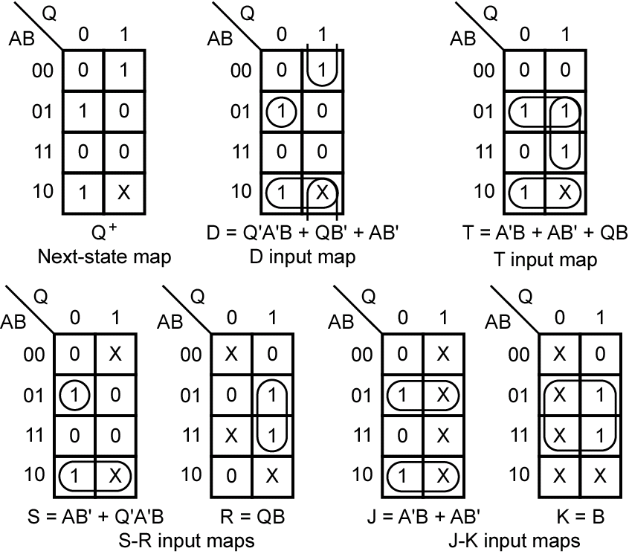
12.6 Derivation of Flip-Flop Input Equations-Summary
Example (illustrating the use of Table 12-9)

Slide 42
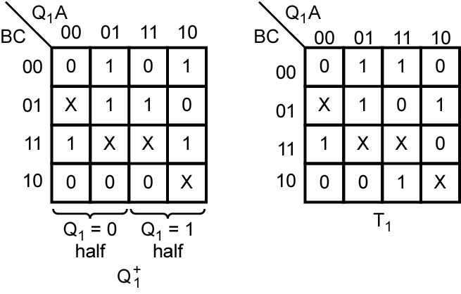
12.6 Derivation of Flip-Flop Input Equations-Summary
Fig 12-32(a)
Derivation of
Flip-Flop Input
Equations Using
4-Variable Maps

Slide 43
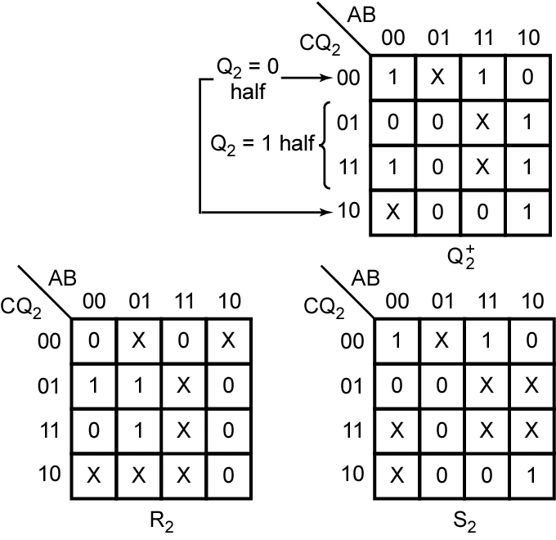
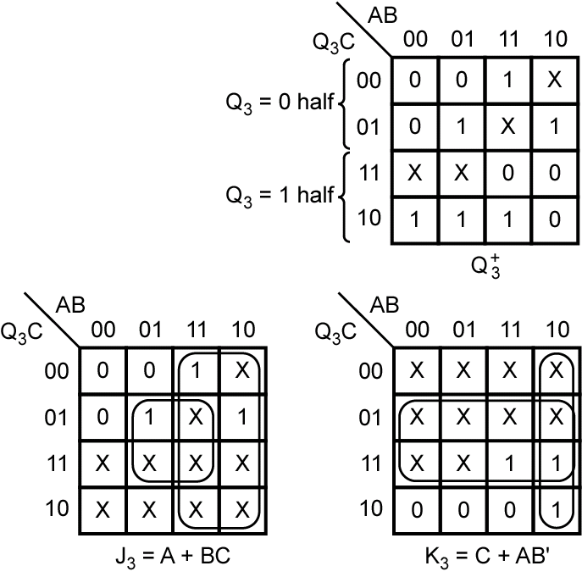
12.6 Derivation of Flip-Flop Input Equations-Summary
Fig 12-32(b) (c)
Derivation of Flip-Flop Input Equations Using 4-Variable Maps

